Slide 1
A machine learning "Rosetta Stone" for psychologists and psychometricians
Alan D. Mead, Talent Algorithms Inc.
Jialin Huang, Amazon

Slide 2
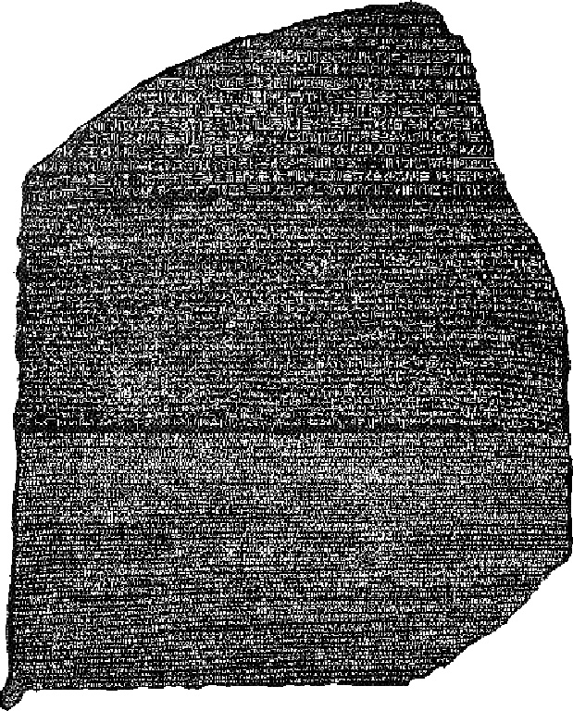
Why a “Rosette Stone”?
We’ve been doing “big data” analyses for a century
Johnny-come-lately “data scientists” are re-inventing our vocabulary…
  … and possibly eating our lunch
This glossary of terms is a first step towards
  understanding these guys, and
  incorporating the new aspects of data science

Slide 3
Machine learning
Artificial intelligence (AI)
Statistical analysis
Text mining
▶
Primarily means “statistics” and “statistical analysis”
Also refers generically to AI approaches using statistical modeling (which may be extremely varied)
Abbreviated ML

Slide 4
Big Data
▶
Nothing (a meaningless buzzword)
Statistical analysis
Text mining
Means different things to different people
  Infrastructure to hold huge amounts of data
  Analysis of truly large samples (often using simple analyses like crosstabs)
Refers generically to statistical analysis

Slide 5
Supervised Learning
▶
Criterion-related analysis
Statistical analyses
Text mining
“Learning” means statistics/statistical analysis
“Supervised” refers to analyses with a “Y-variable”
Cluster analysis is an example of unsupervised learning; so are most “mining” analyses, which search for hidden patterns in the dataset

Slide 6
K-fold Crossvalidation
Wherry’s correction for shinkage
Criterion-related validation
Resampling crossvalidation
▶
Divide the sample randomly into K (equal) subsets
Perform K crossvalidation analyses; in each analysis the Kth subset is the holdout sample, the rest form the calibration sample
Estimates variability in crossvalidation
Double-crossvalidation is 2-fold crossvalidation
If K=N => leave one out crossvalidation (LOOCV)

Slide 7
Features
Dependent variable(s)
Independent variable(s)
Factors, like in factor analysis
▶
Encompasses nominal, ordinal, interval and ratio measures
Often (e.g., optical character recognition), the features need to be “extracted” from the data (they are not “measured” directly and discretely)

Slide 8
Co-occurrence Matrix
▶
Correlation matrix for nominal features
A text mining methodology
A statistic showing similarity
Assumes features (e.g., words) in groups that are the unit of analysis (e.g., items)
Counts the occurrence of a feature in a group
A factor-analysis like process produces a latent semantic space

Slide 9
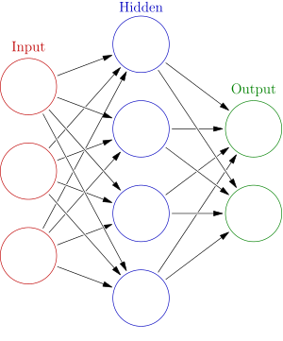
Artificial Neural Network (ANN)
Artificial intelligence (AI)
Unsupervised learning algorithm
Supervised learning algorithm
▶
Non-parametric, nonlinear regression for nominal DV’s; complex fitting
Has it’s own terminology (nodes, layers, activation, etc.)
Can have enormous numbers of parameters; thus the model is typically incomprehensible

Slide 10
Naïve Bayes
Artificial intelligence (AI)
Unsupervised learning algorithm
Supervised learning algorithm
▶
Only classifies (nominal DV)
May have very large number of dichotomous IV’s
Simple estimation
Naïve refers to assuming IV’s are independent; i.e., that P(IV1=1 & IV2=1) = P(IV1=1) P(IV2=1)

Slide 11
One Hot Encoding
Data imputation
Dummy coding
Data cleaning
▶
May include schemes where K values get K dummy codes (not K-1)
Co-occurrence matrix is table of OH encodings
Comes from digital circuits (“one hot”=“a single 1 in a group of binary values”)

Slide 12
Bagging
Statistical analysis
Resampling crossvalidation
Resampling model-fitting
▶
Bootstrap aggregating, an “ensemble meta-algorithm” to improve stability
Re-sample (with replacement) your N observations to create D bootstrap samples of size N; average the output (for regression) or vote (for classification).

Slide 13
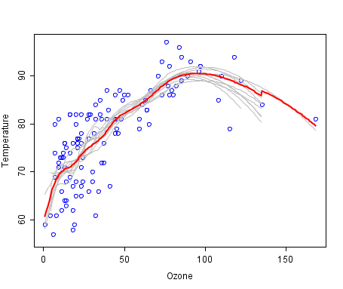
Bagging example
Source: https://en.wikipedia.org/wiki/Bootstrap_aggregating

Slide 14
Boosting
Artificial intelligence (AI)
Statistical analysis
Text mining
▶
Primarily means “statistics” and “statistical analysis”
Also refers generically to AI approaches using statistical modeling
Abbreviated ML

Slide 15
What new in data science?
Little balkanization; predicting anything from anything
Includes methods that are supervised and unsupervised (“mining” for patterns)
Resampling to improve efficiency and reduce instability
New terminology
Wider variation in problems and methodologies

Slide 16
Thanks!
Questions?
Alan Mead <amead@alanmead.org>
Jialin Huang <huangpsych@gmail.com>

Slide 17
Further reading… Wikipedia?!?
Yes, Wikipedia provides excellent definitions
Rosetta Stone
Machine Learning
Big Data
Supervised Learning
K-fold crossvalidation
Feature
Co-occurrence matrix
Artificial Neural Network
Naïve Bayes
One hot encoding
Bagging
Boosting

